Slide 1

WAY TO ENTERPRISE
Advanced Java
VTI ACADEMY
Author: duy.nguyenngoc1@vti.com.vn
March 2020

Slide 2
Agenda
Course Overview
HelloWorld Program
CRUD Program
Introduce Hibernate & other library
Annotation Mapping
Assignments
Copyright © VTI Academy All Rights Reserved

Slide 3
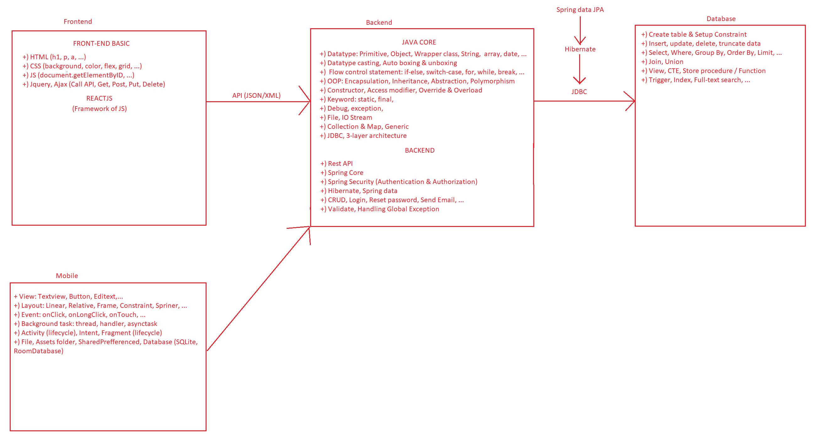
Course Overview

Slide 4
HelloWorld Program
Step 1: Import Database script
Step 2: Create Maven Project & Install library
Step 3: Create the Configuration file
Step 4: Create Persistent Object
Step 5: Test

Slide 5
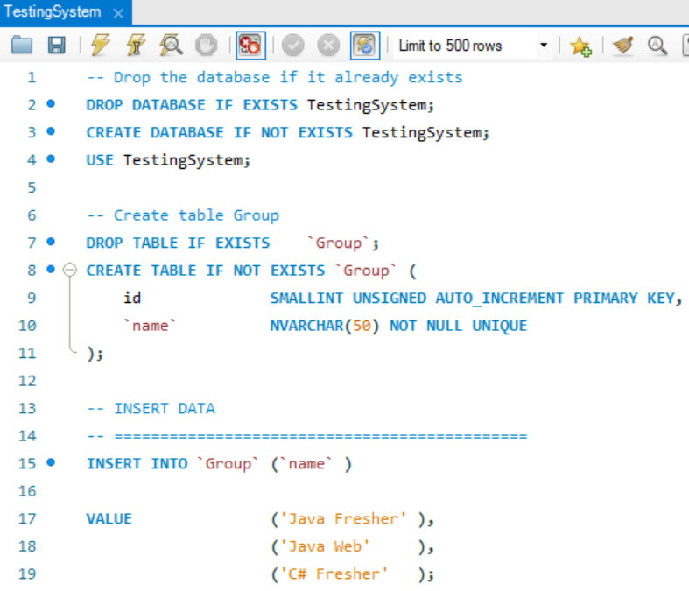
HelloWorld Program
Step 1: Import Database script

Slide 6
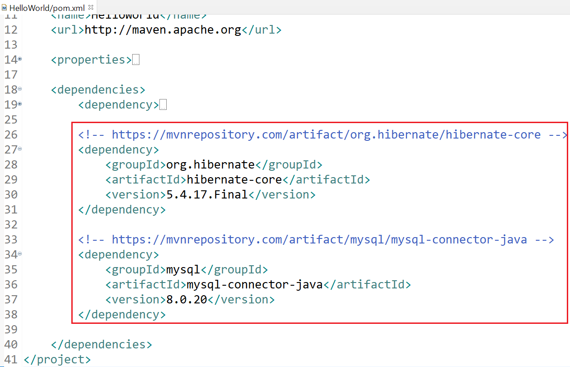
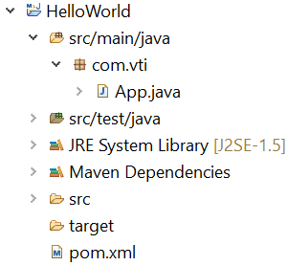
HelloWorld Program
Step 2: Create Maven Project & Install library
https://mvnrepository.com/artifact/org.hibernate/hibernate-core/5.4.17.Final
https://mvnrepository.com/artifact/mysql/mysql-connector-java/8.0.20

Slide 7
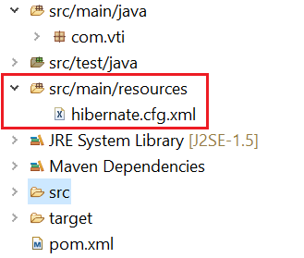
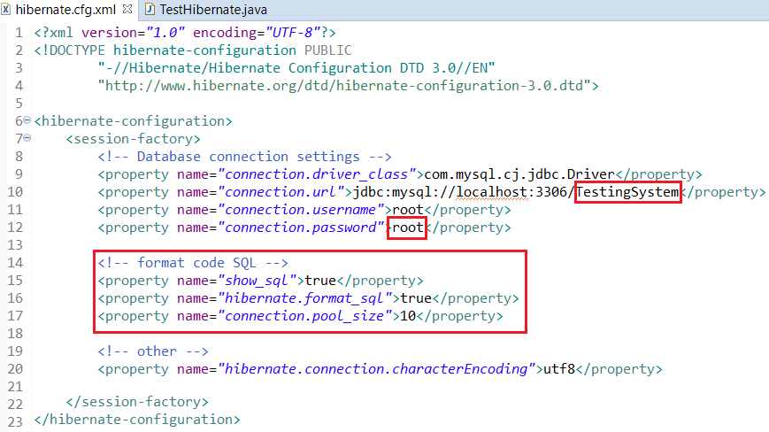
HelloWorld Program
Step 3: Create the Configuration file

Slide 8
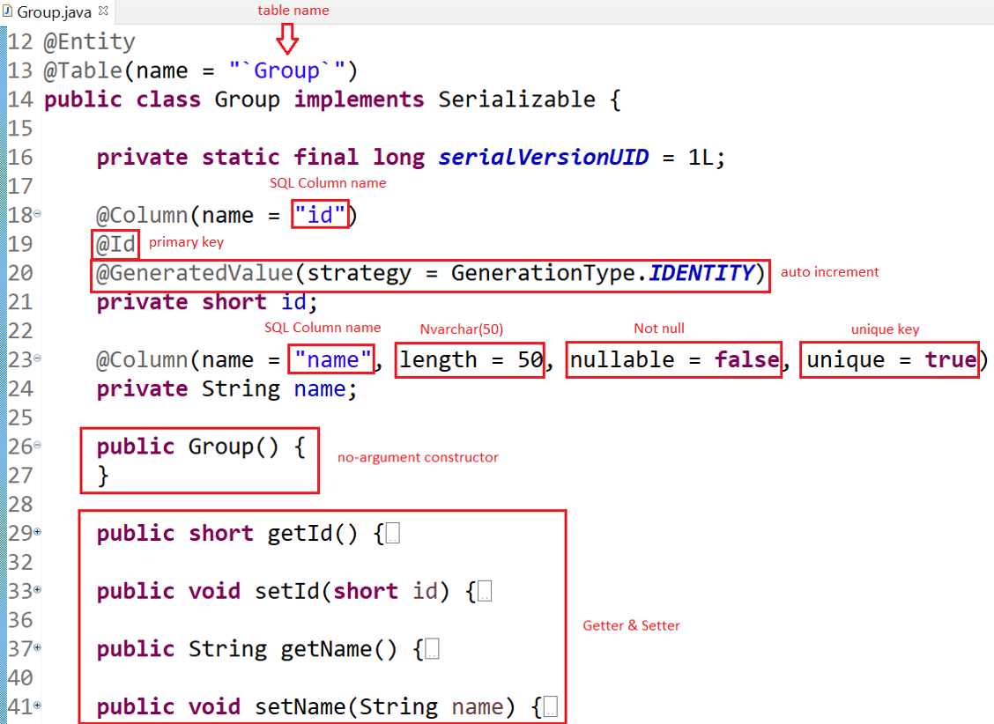
HelloWorld Program
Step 4: Create Persistent Object

Slide 9
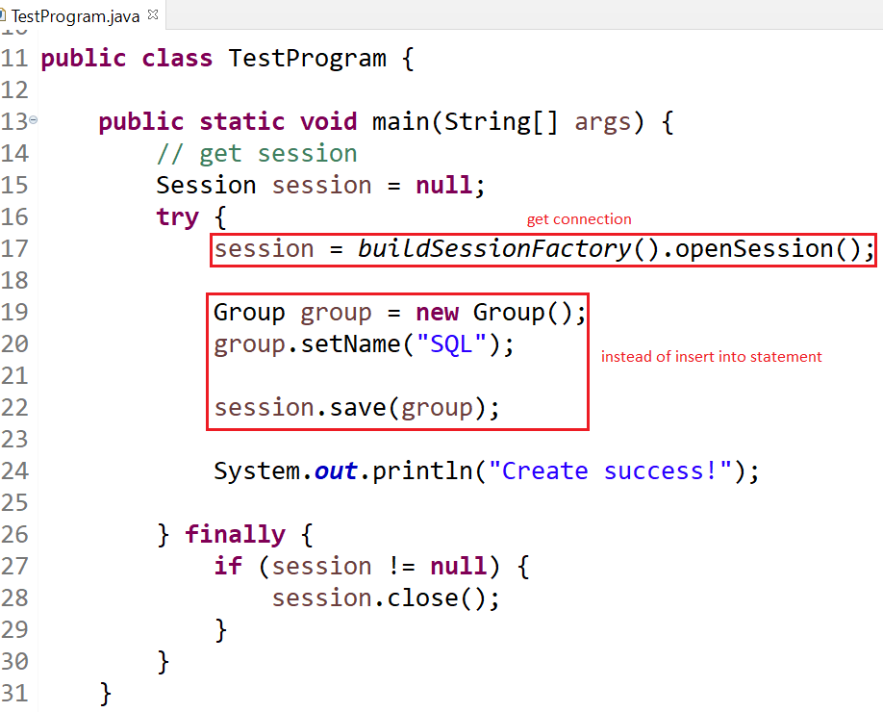
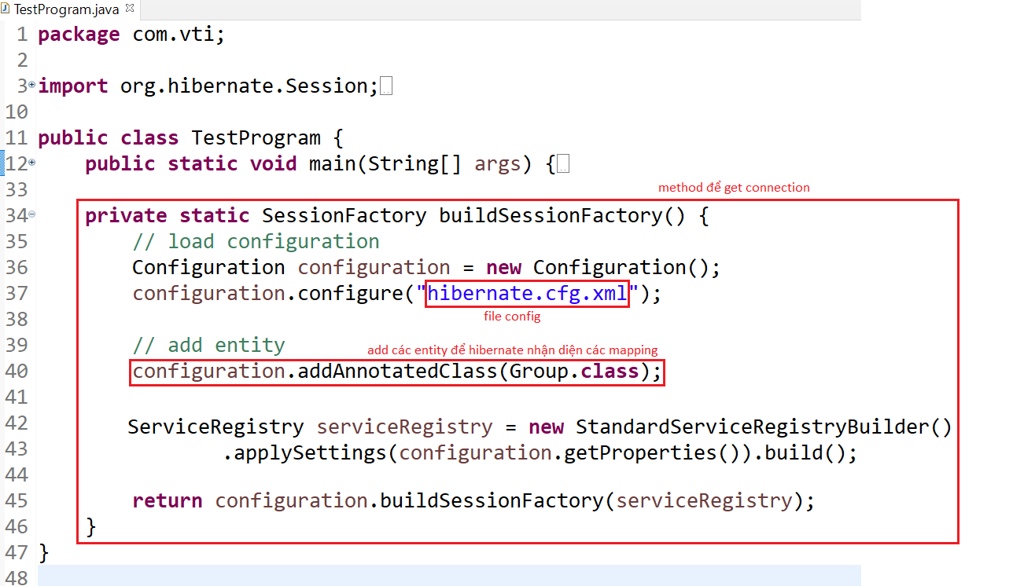
HelloWorld Program
Step 5: Test

Slide 10
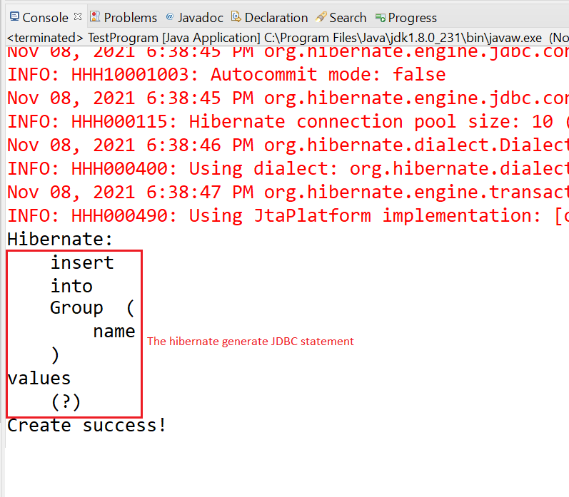
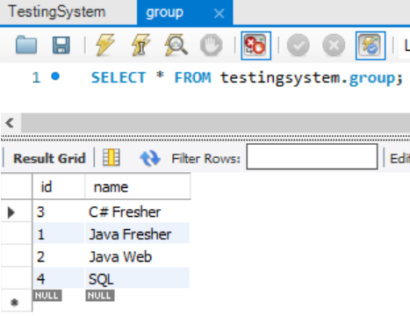
HelloWorld Program
Result

Slide 11
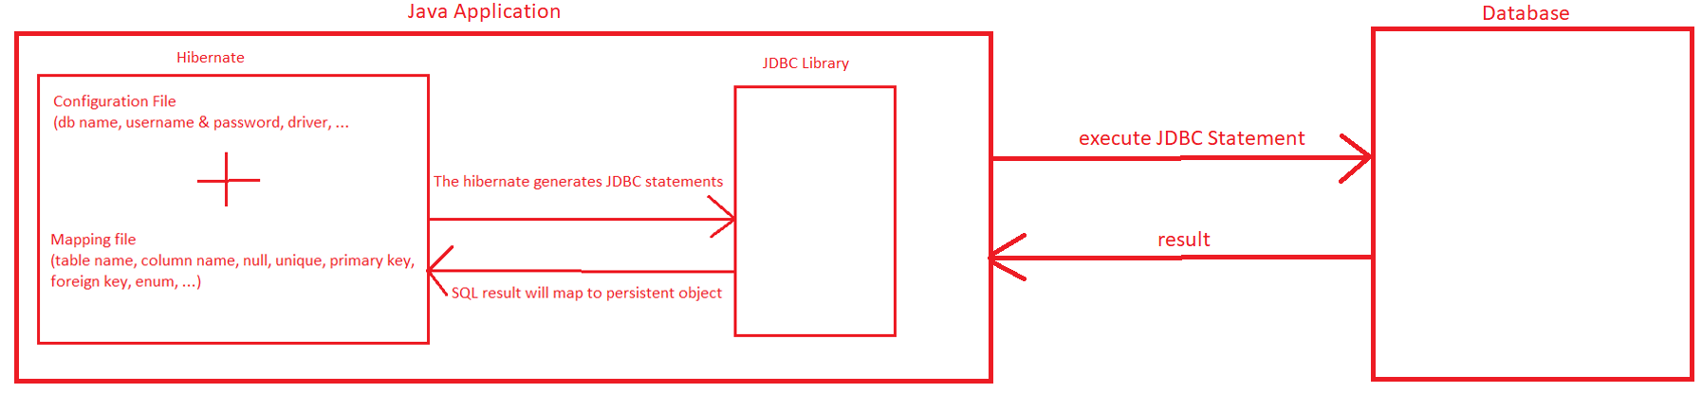
HelloWorld Program
Summary

Slide 12
Testing System Assignment
Self-practice

Slide 13
CRUD Program
Step 1: Config Project
Step 2: View List function
Step 3: Get by id function
Step 4: Get by name function
Step 5: Create function
Step 6: Update function
Step 7: Delete function
Step 8: Check exists by id function
Step 9: Check exists by name function

Slide 14
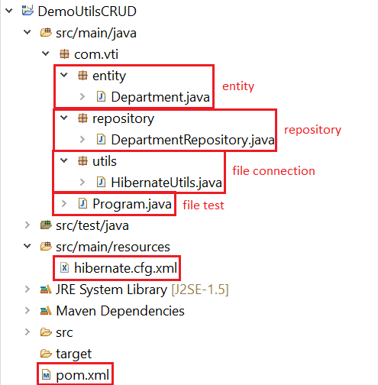
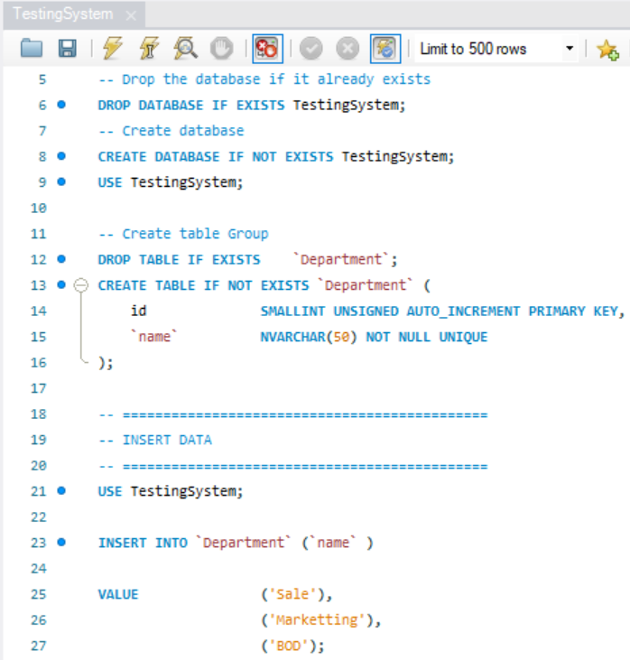
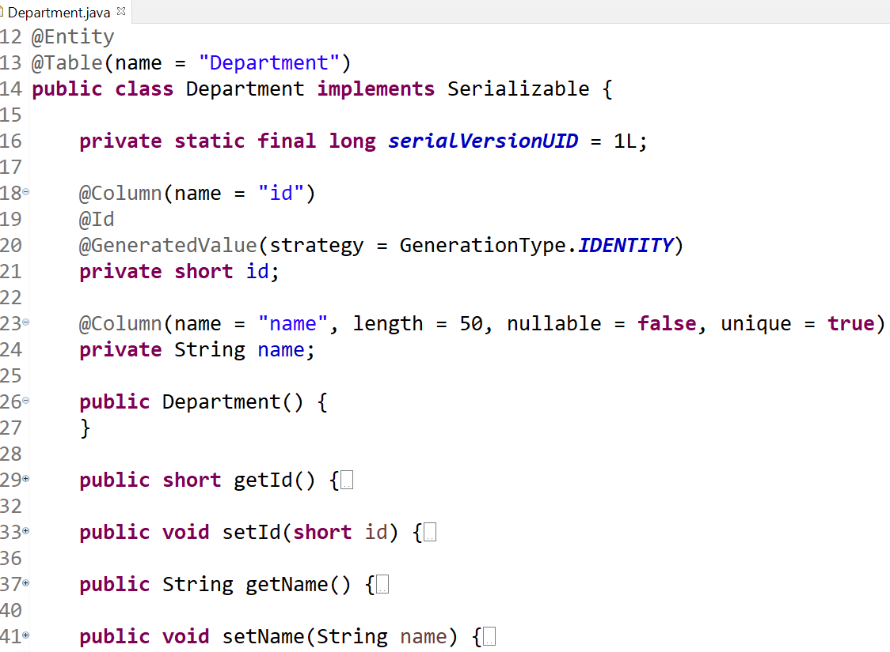
CRUD Program
Step 1: Config Project
Import Database
Persistent Object

Slide 15
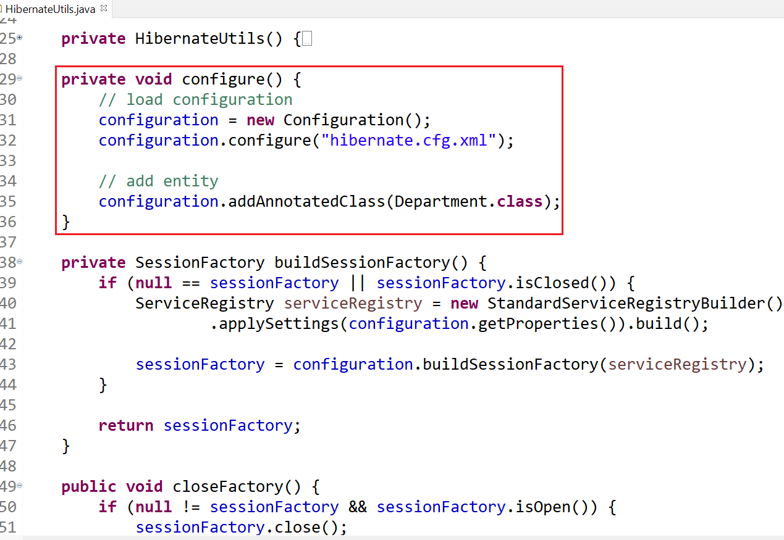
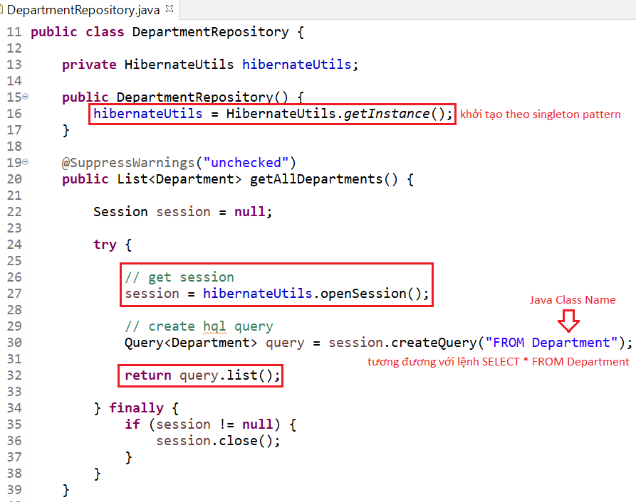
CRUD Program
Step 2: View List function
Hibernate Utils
View List

Slide 16
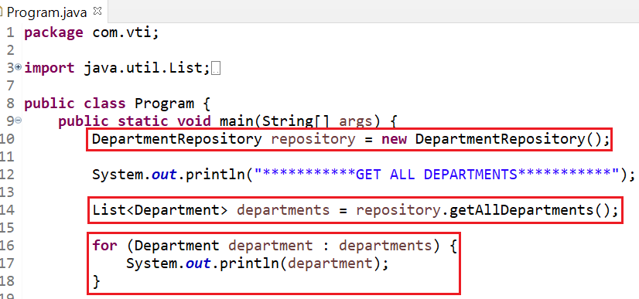
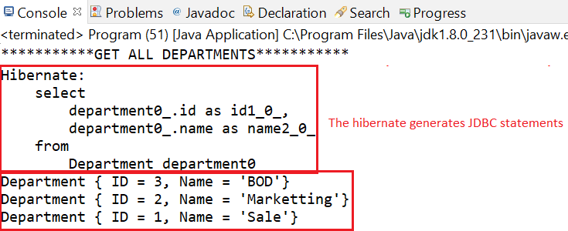
CRUD Program
Using

Slide 17
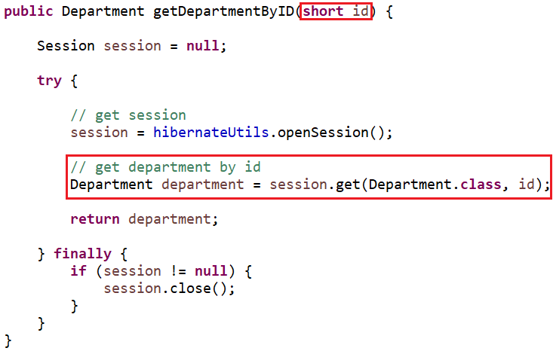
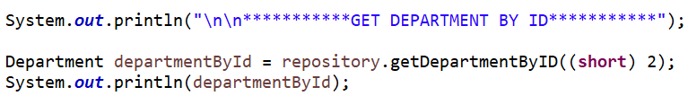
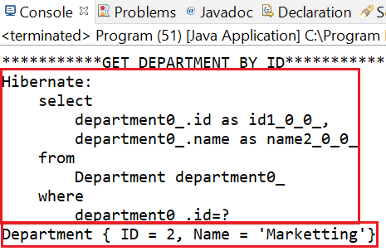
CRUD Program
Step 3: Get by id function

Slide 18
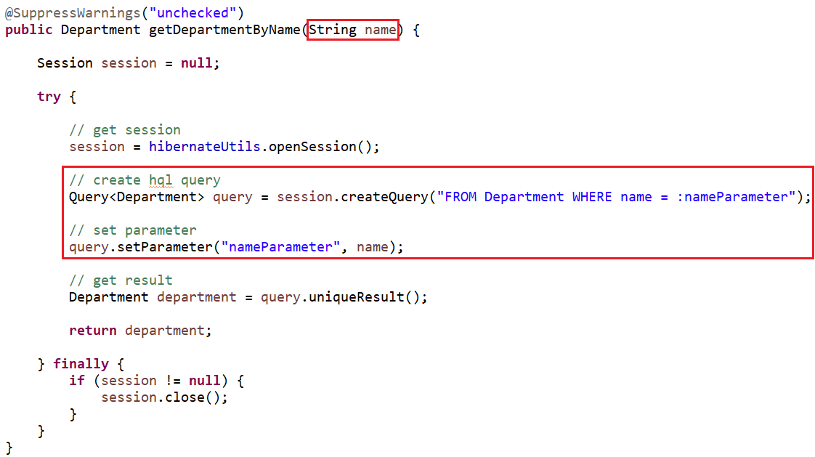
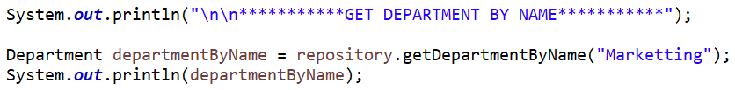
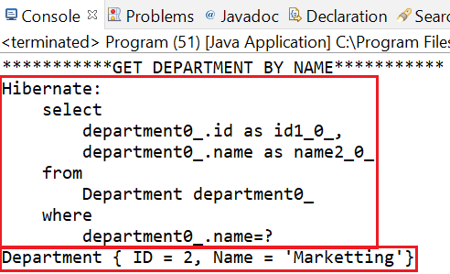
CRUD Program
Step 4: Get by name function

Slide 19
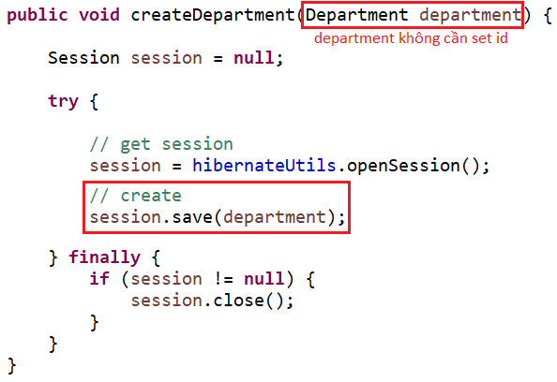
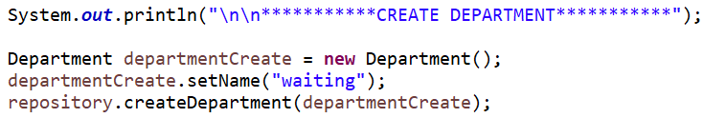
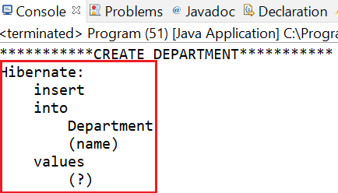
CRUD Program
Step 5: Create function

Slide 20
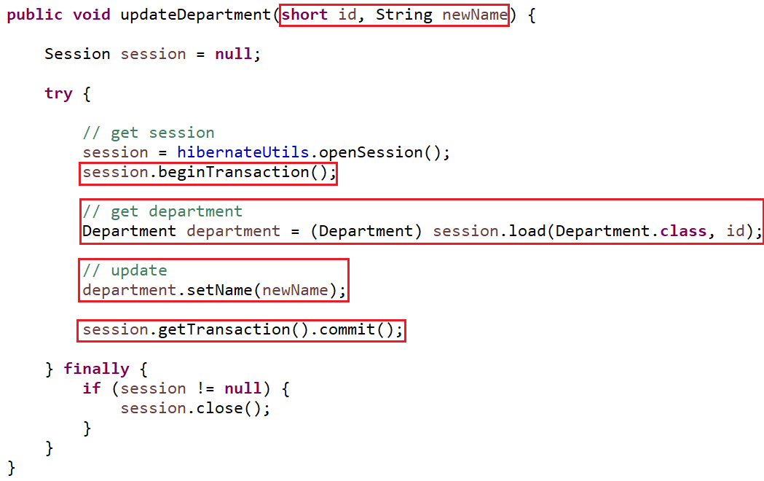

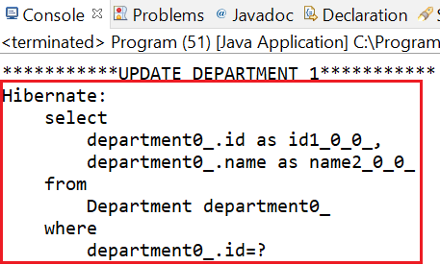
CRUD Program
Step 6: Update function

Slide 21
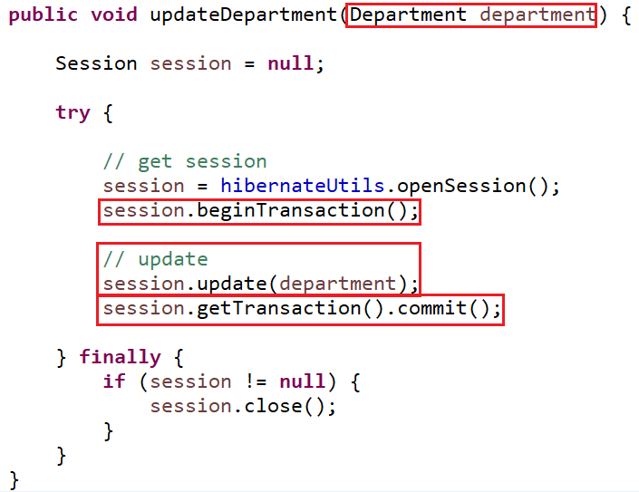
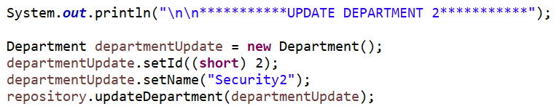
CRUD Program

Slide 22
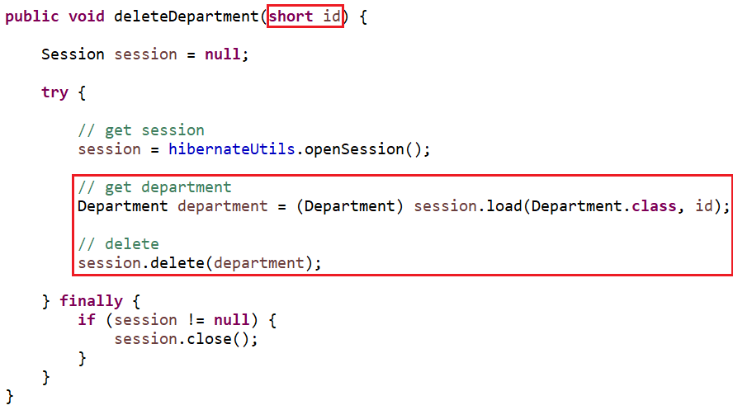
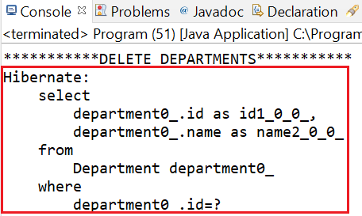
CRUD Program
Step 7: Delete function

Slide 23
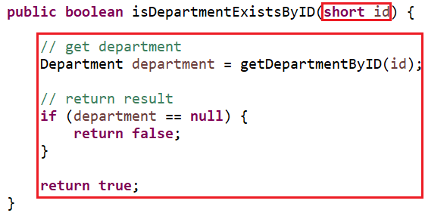
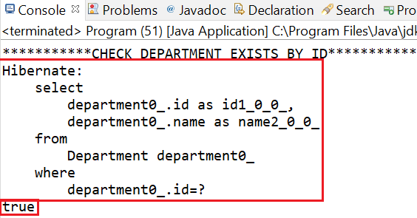
CRUD Program
Step 8: Check exists by id function

Slide 24
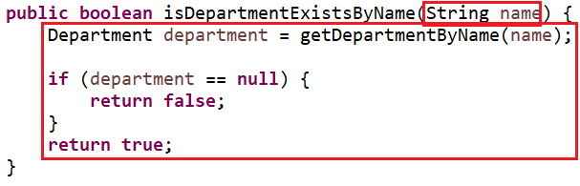
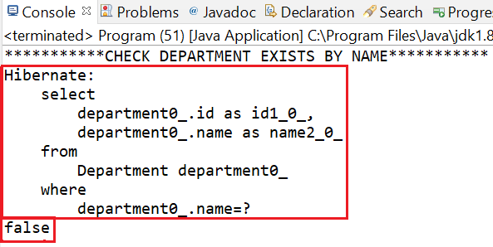
CRUD Program
Step 9: Check exists by name function

Slide 25
CRUD Program
Summary

Slide 26
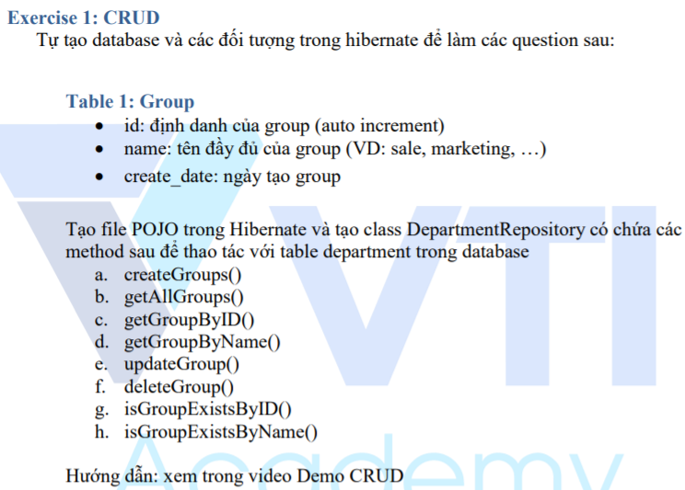
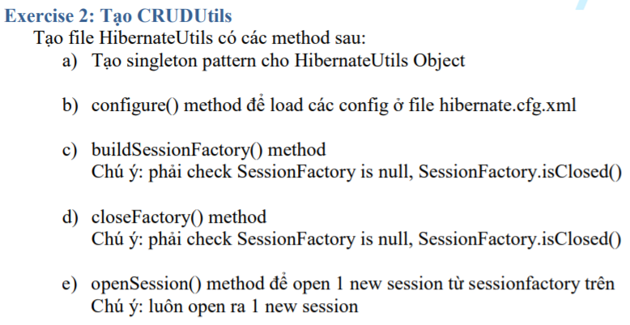
Testing System Assignment
Self-practice

Slide 27
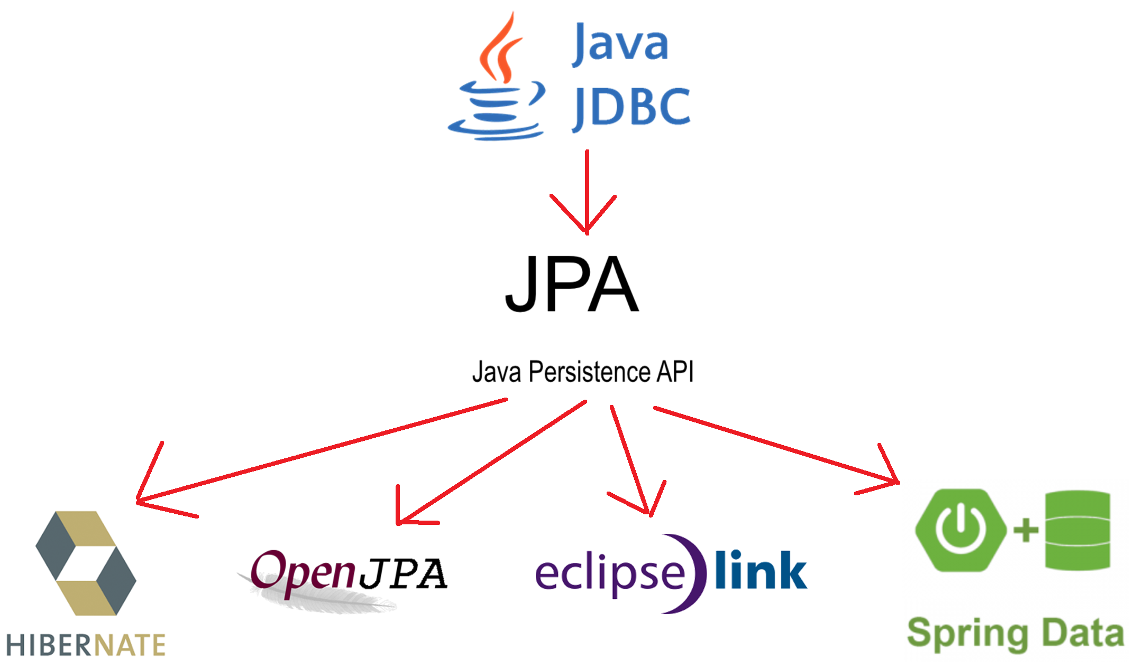
Connecting Database Libraries

Slide 28
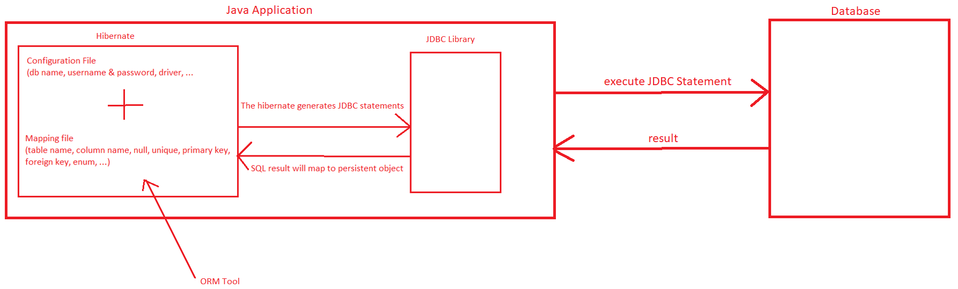
ORM Tool
Stands for Object Relational Mapping
Simplifies the data creation, data manipulation and data access.
ORM is a programming technique that maps the object to the data stored in the database.

Slide 29
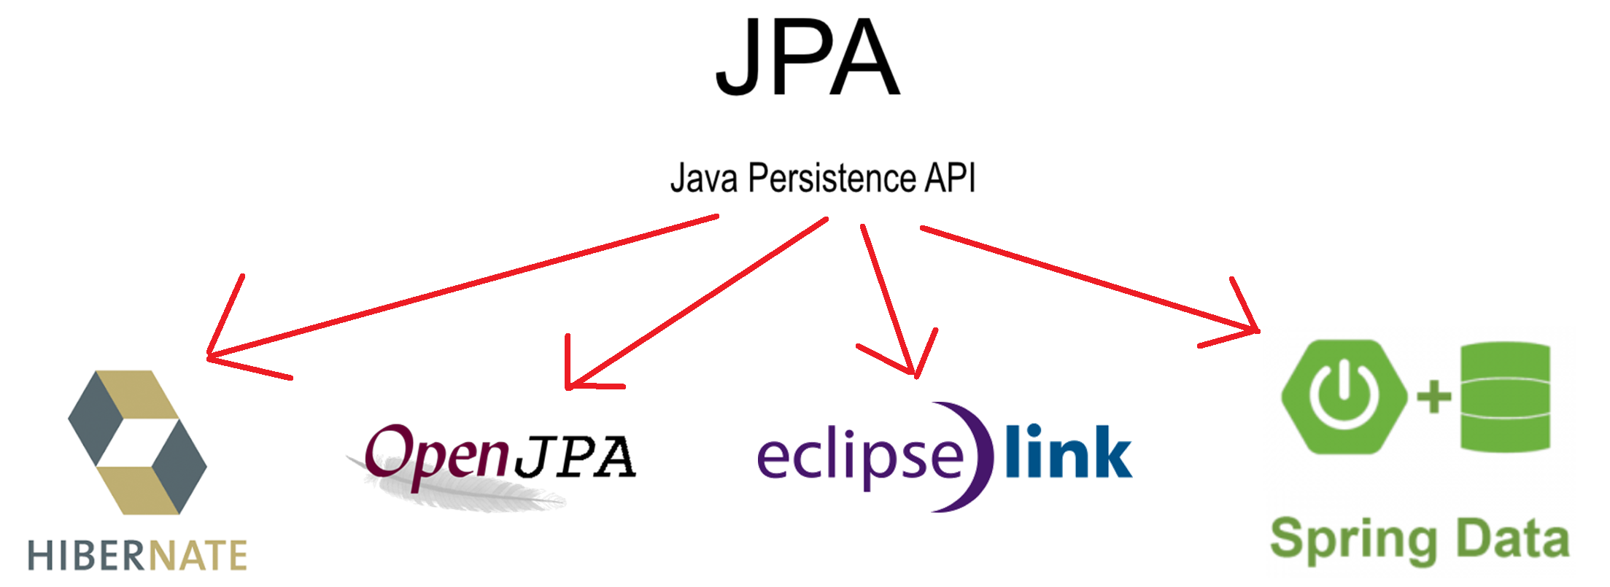
JPA
Java Persistence API (JPA) is a Java specification that provides certain functionality & standard to ORM tools

Slide 30

Hibernate
It is an open source, lightweight, ORM (Object Relational Mapping) tool
Hibernate can generate the database, automatic Table Creation (Code first)
Simplifies Complex Join
Provides Query Statistics and Database Status

Slide 31
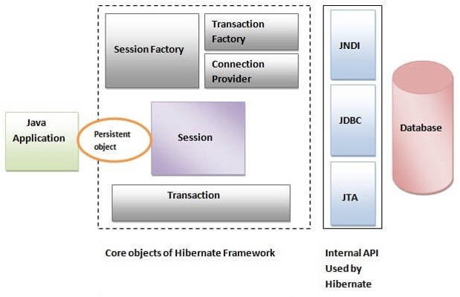
Hibernate
Architecture

Slide 32
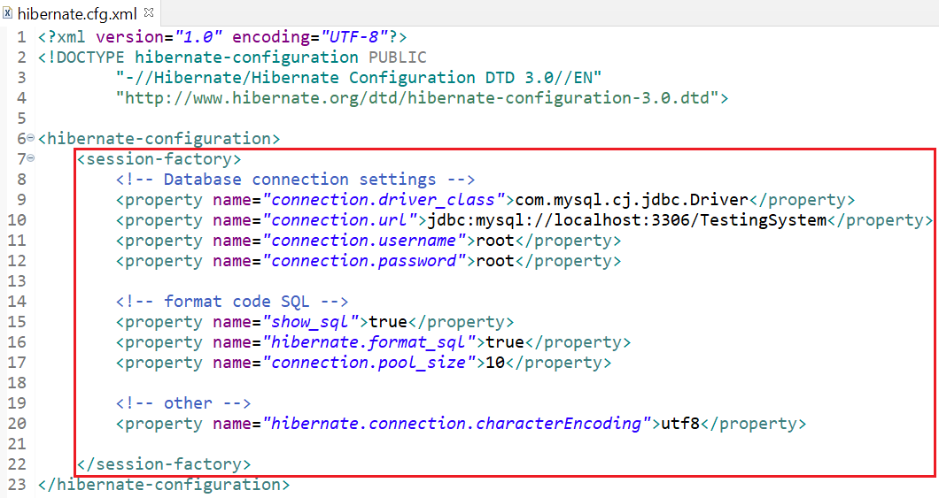
SessionFactory
Created during startup and kept for using.
Each Database will correspond to a SessionFactory (since each database uses a separate configuration file)

Slide 33
Session
Used to make a physical connection from Java to the database
Initialized each time you interact with the database
The Session object is continuously saved and retrieved via a SessionFactory object

Slide 34
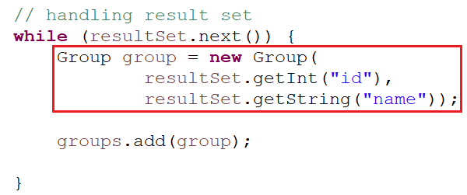
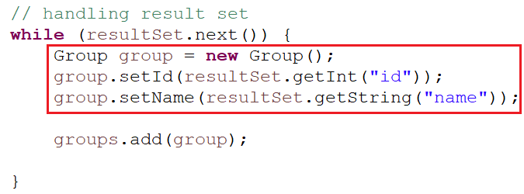
Persistent object
Persistent Object (Plain Old Java Object - POJO)
Require:
A no-arg constructor
Have a id property as primary key in database’s table
Declare getter and setter methods
Non-final class
JDBC
Hibernate

Slide 35
Transaction, Query, Criteria
Next Lesson

Slide 36
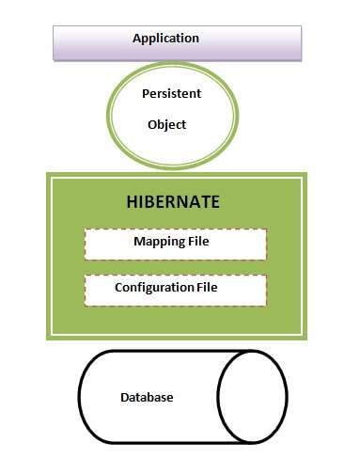
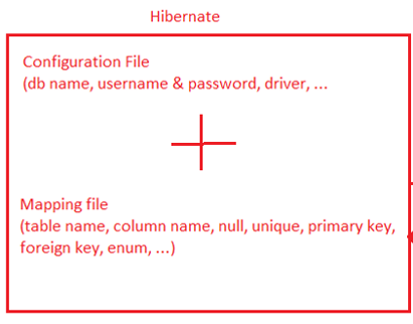
Configuration
Configuration File
Mapping File

Slide 37
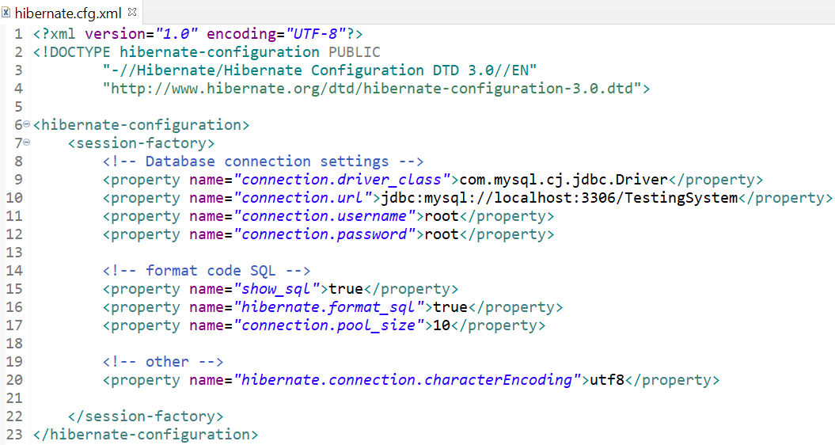
Configuration File

Slide 38
Mapping File
Config by 2 ways:
xml file
annotation
Config by annotation

Slide 39

Mapping File
Config by annotation & xml

Slide 40
Annotation Mapping
Primitive type
Date & DateTime
Enum (Next Lesson)
@Table, @Column, @Formula, Default value, @PrePersist

Slide 41
Annotation Mapping
Primitive type
Java | Database
short (Short) | TINYINT
short (Short) | SMALLINT
int (Integer) | INT
long (Long) | BIGINT
float (Float) | FLOAT
double (Double) | DOUBLE
BigDecimal | DECIMAL
String | CHAR, VARCHAR, NCHAR, NVARCHAR, TEXT
boolean (Boolean) | BIT

Slide 42

Example
Entity

Slide 43



Annotation Mapping
Date & DateTime
Java | Database
@Temporal(TemporalType.DATE) | Date
@Temporal(TemporalType.TIME) | Time
@Temporal(TemporalType.TIMESTAMP) | DateTime
java.util.date
Tutorial: https://www.baeldung.com/hibernate-date-time

Slide 44

Annotation Mapping
@Entity: Define class which has @Entity is a Database’s table

Slide 45


Annotation Mapping
@Table
name: table’s name
catalog: database’s name
uniqueConstraints: config multiple column unique

Slide 46
Annotation Mapping
@Column
name: column’s name
length: varchar has default 255
nullable: field is configed null or not null
unique: field is configed unique or not unique
insertable: we can insertable this field into database (default = true)
Ex insertable = false: id, created_date, ...
updatable: we can updatable this field into database (default = true)
Ex updatable = false: id, account, created_date, ...

Slide 47

Annotation Mapping

Slide 48



Annotation Mapping
@Formula: Fake field (logic property)

Slide 49

Annotation Mapping
Default value

Slide 50

Annotation Mapping
Default Date

Slide 51


Annotation Mapping
@PrePersist: the method which execute before database

Slide 52

Testing System Assignment

Slide 53

Testing System Assignments

Slide 54
Reference
https://www.javatpoint.com/hibernate-tutorial
https://www.baeldung.com/

Slide 55
Q & A
Copyright © VTI Academy All Rights Reserved

